Slide 1
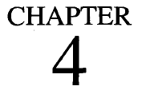
Artificial Neural Networks
B. Tech III Year
CS 601 PC

Slide 2
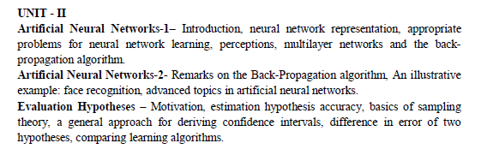
Chapters : 4 – 5
H
E
R
E
C
H
4
C
H
5

Slide 3
Artificial neural networks (ANNs) provide a general, practical method for learning :
real-valued,
discrete-valued, and
vector-valued functions from examples.
Algorithms such as Back Propagation and Gradient Descent to tune
network parameters to best fit a training set of input-output pairs.
ANN learning is robust to errors in the training data and has been
successfully applied to problems such as :
interpreting visual scenes,
speech recognition, and
learning robot control strategies

Slide 4
Artificial Neural Networks (ANNs)
ANNs are computational models which work similar to the functioning of a human nervous system. There are several kinds of ANNs. These type of networks are implemented based on the mathematical operations and a set of parameters required to determine the output.
NNs can be :
- Biological models
- Artificial models
- Desire to produce artificial systems capable of
sophisticated computations similar to the human brain.

Slide 5
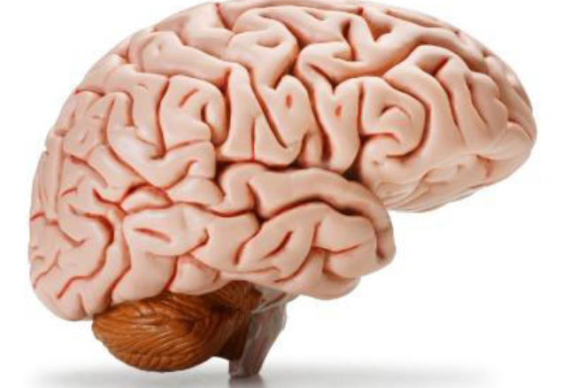
Brain vs Digital Computers
Computers require hundreds of cycles to simulate
a firing of a neuron.
- The brain can fire all the neurons in a single step.
Parallelism
- Serial computers require billions of cycles to
perform some tasks but the brain takes less than
a second.
e.g. Face Recognition

Slide 6
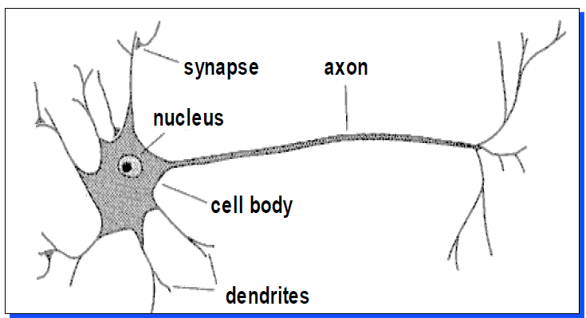
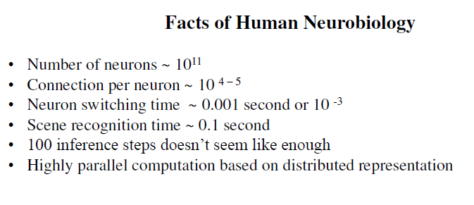

Slide 7
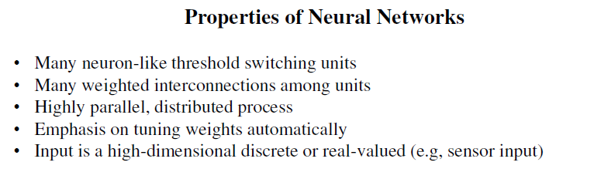

Slide 8
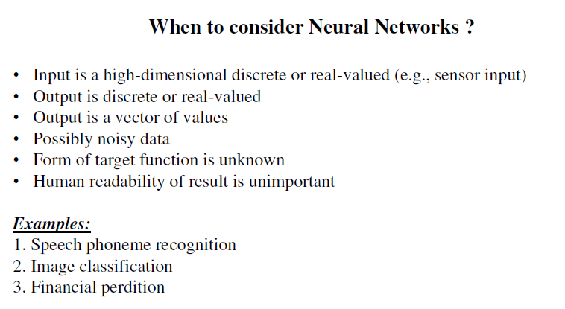

Slide 9
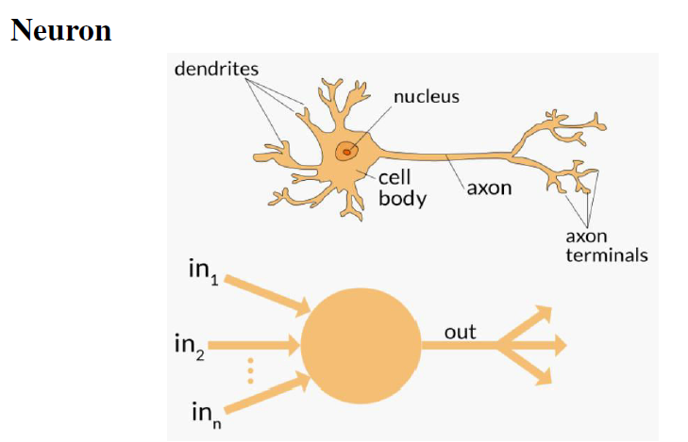

Slide 10
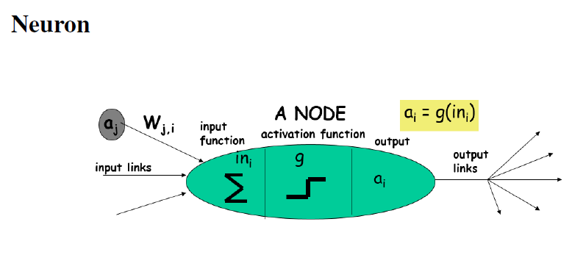

Slide 11
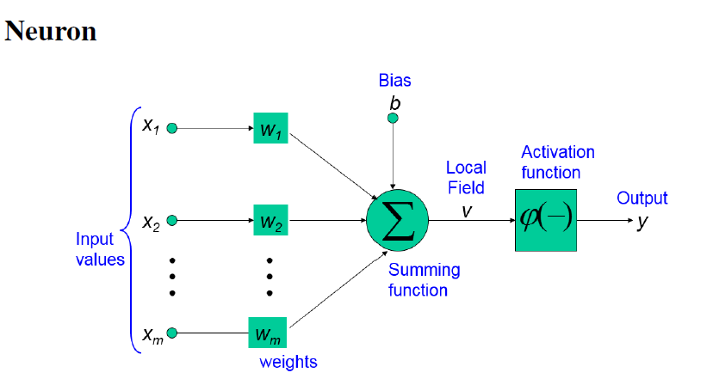

Slide 12
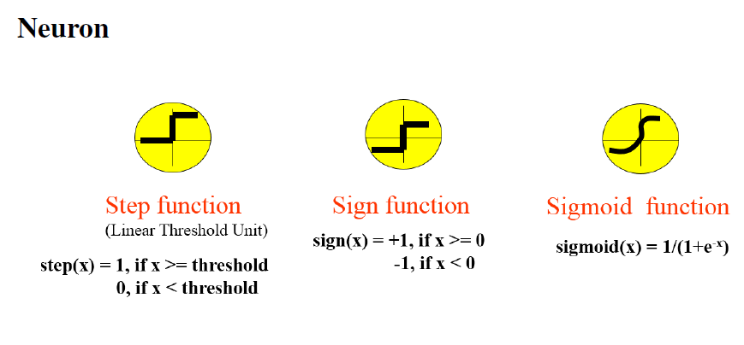

Slide 13
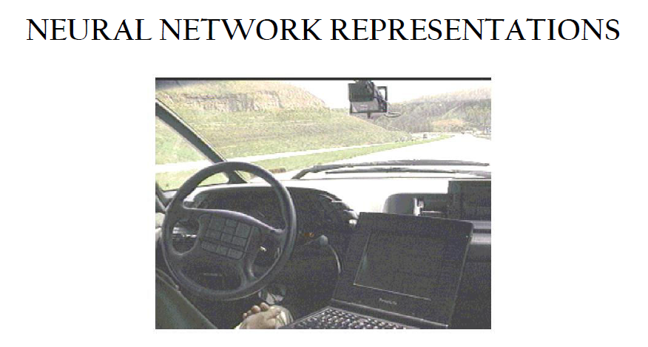

Slide 14
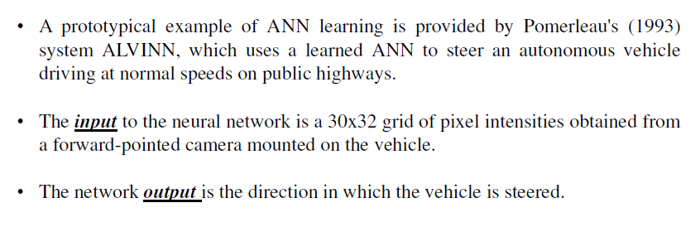

Slide 15
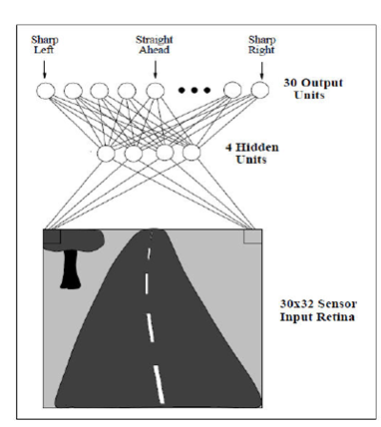
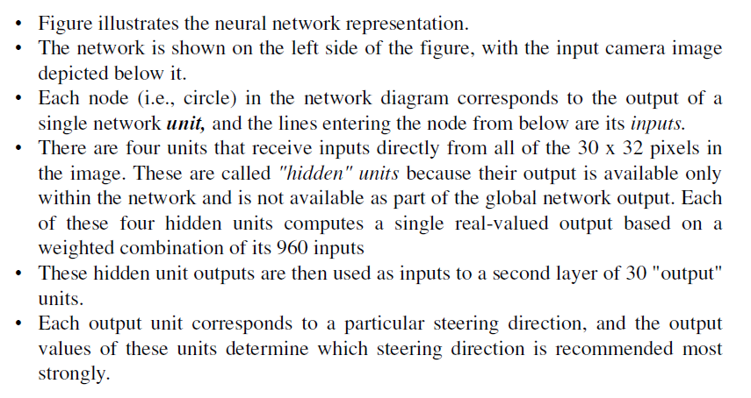

Slide 16
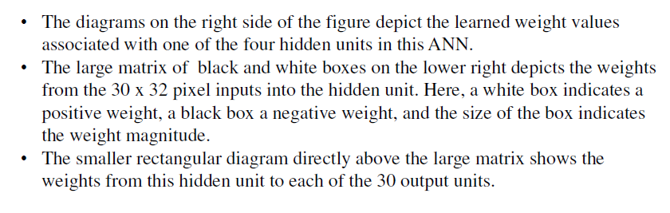
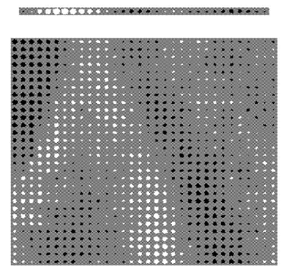

Slide 17
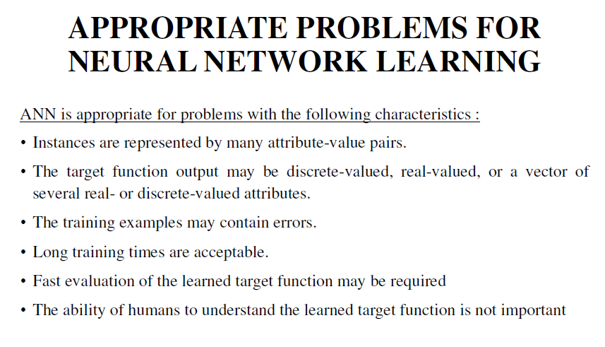

Slide 18
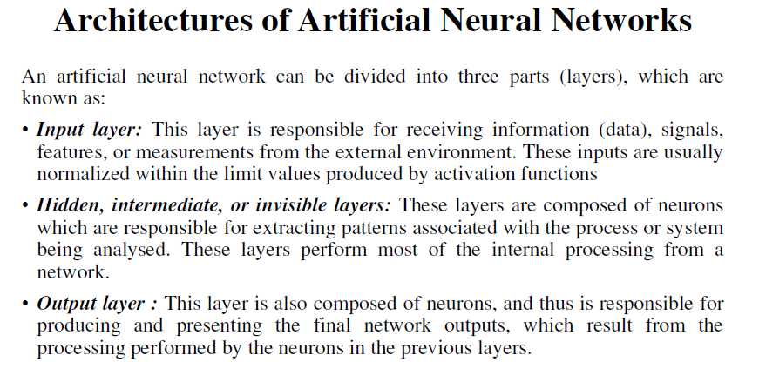

Slide 19
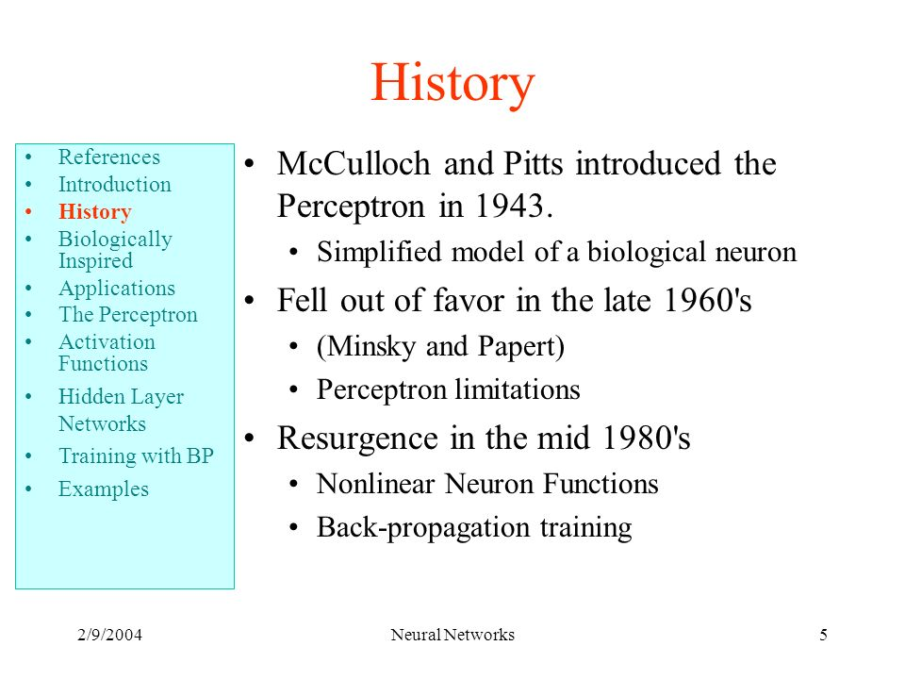
4.4 Perceptron

Slide 20
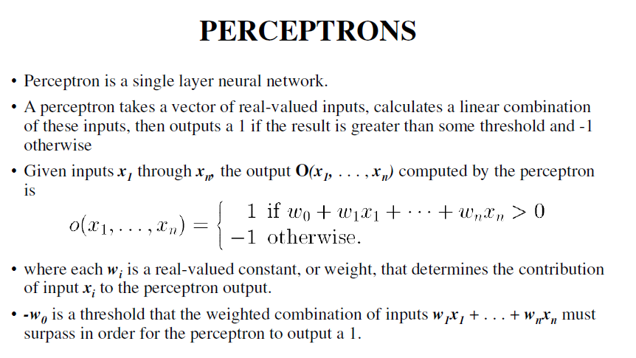

Slide 21
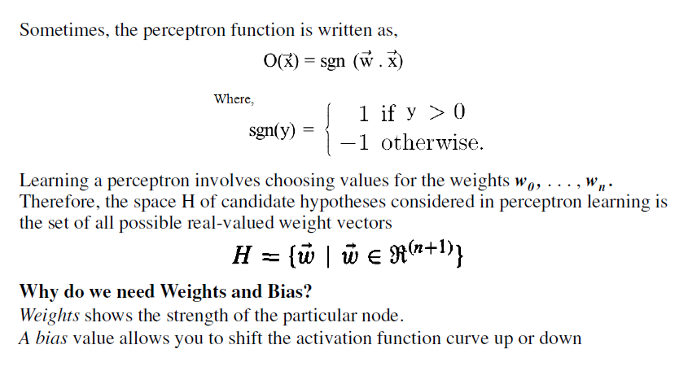

Slide 22
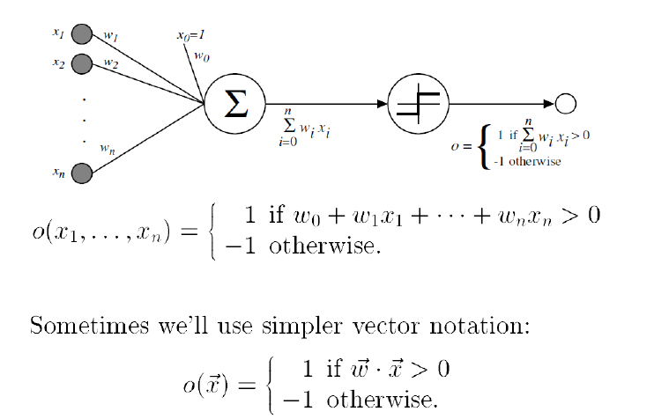

Slide 23
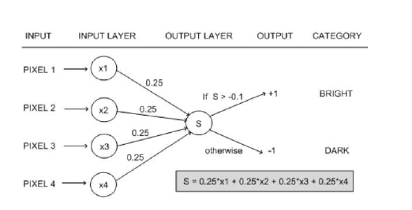

Slide 24
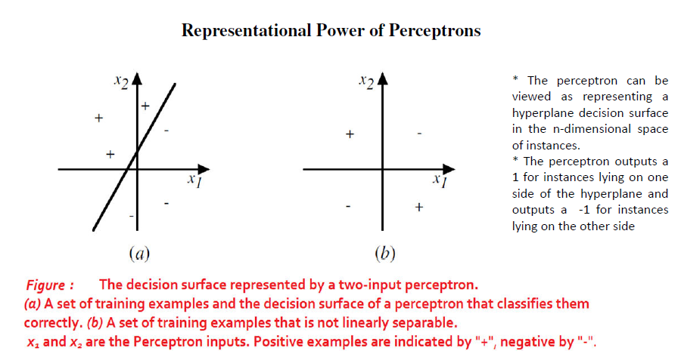
4.4.1

Slide 25
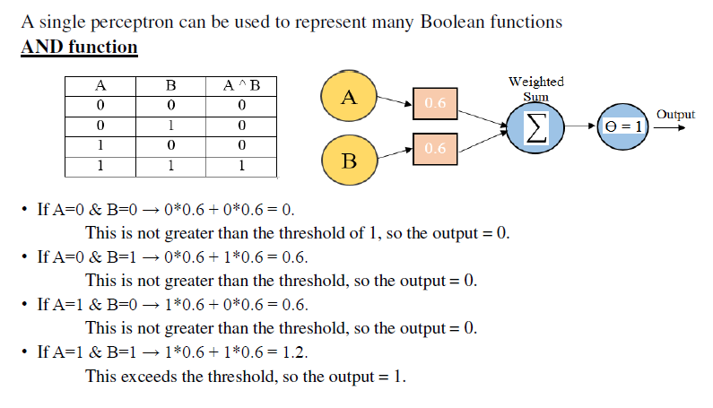

Slide 26
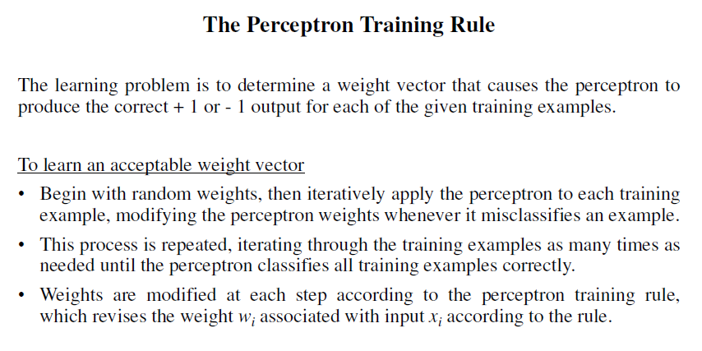
4.4.2

Slide 27
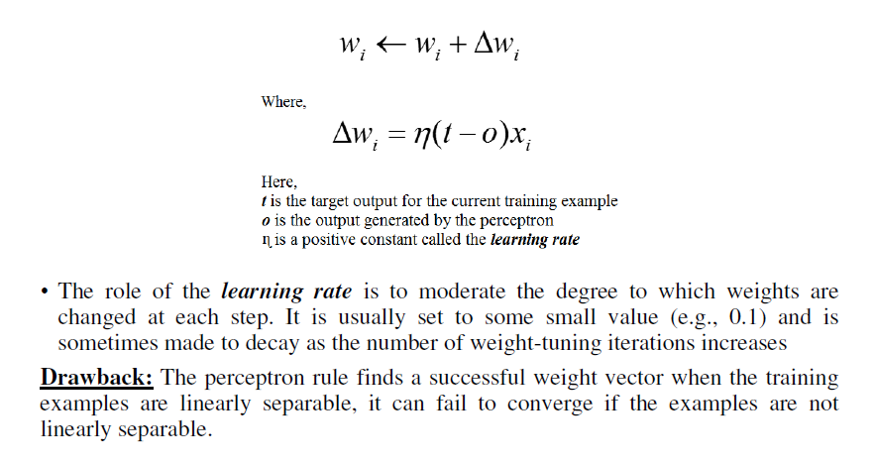

Slide 28
Limitations of the perceptron
While the perceptron classified the instances of AND/OR/NOT well, the model has limitations.
Linear models like the perceptron with a Heaviside activation function are not universal function approximators; they cannot represent some functions.
Specifically, linear models can only learn to approximate the functions for linearly separable datasets.
The linear classifiers that we have examined find a hyperplane that separates the positive classes from the negative classes;
if no hyperplane exists that can separate the classes, the problem is not linearly separable.

Slide 29
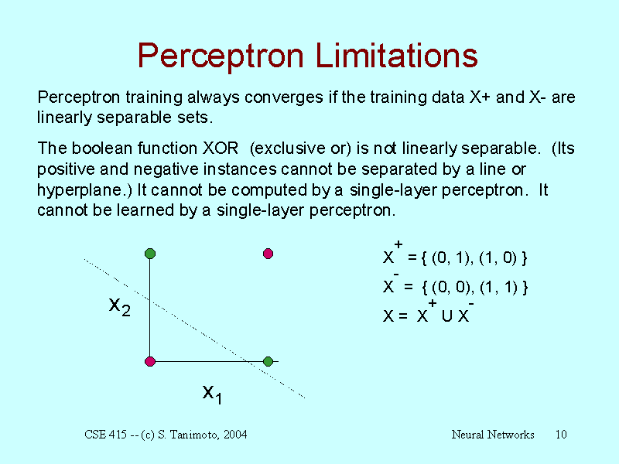

Slide 30
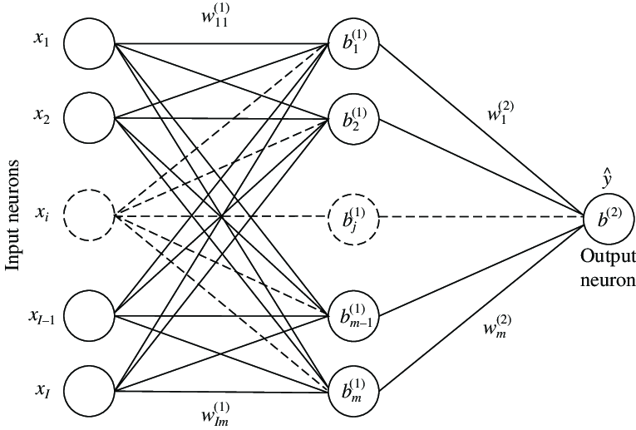
FEED FORWARD NEURAL NETWORK
There are different classes of Artificial Neural Network ( ANN) and each one is linked with its learning algorithm for training:
Single Layer Feed Forward network

Slide 31
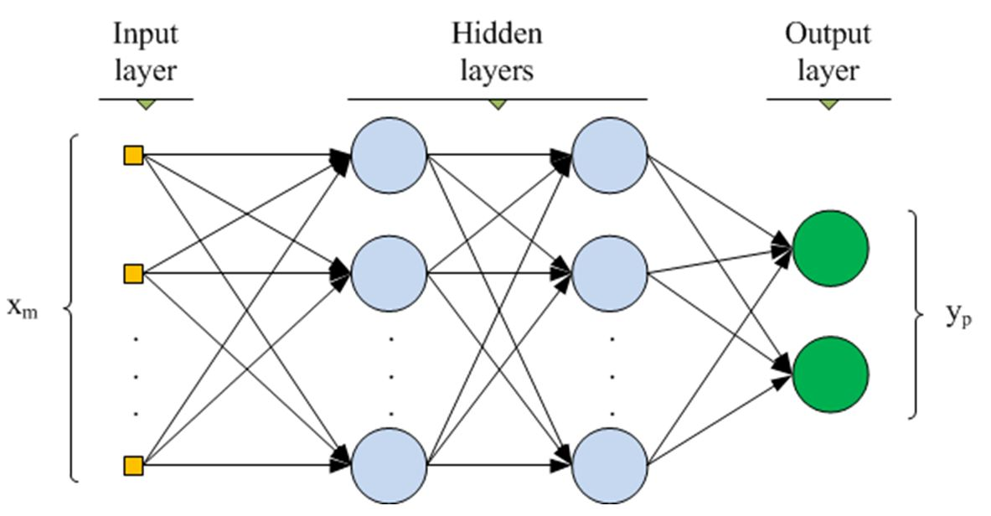
2. Multi-Layer Feed Forward Network

Slide 32
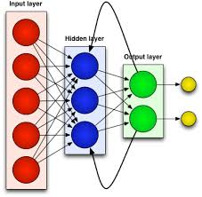
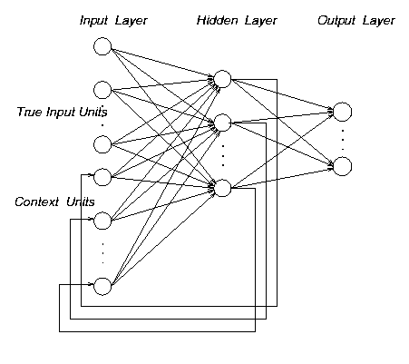
3. Recurrent Network

Slide 33
Topologies of Neural Networks
completely connected
feedforward
(directed, a-cyclic)
recurrent
(feedback connections)
Notes:
Mögliche Topologien für Neuronale Netze:
- vollständig vernetzt: Selbstassoziative Netze (Hopfield)
- feedforward: vielparametrisierter Approximator
- recurrent: zur Modellierung zeitveränderlicher Signale
Für die Approximation zeitkonstanter Signale werden meist vorwärtsgerichtete Neuronale Netze eingesetzt. Darauf beschränken wir uns auch im weiteren...

Slide 34
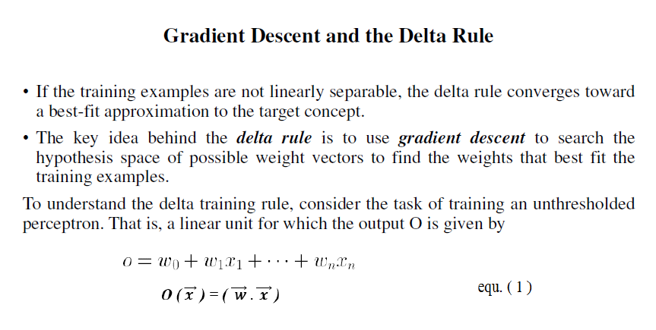
4.4.3

Slide 35
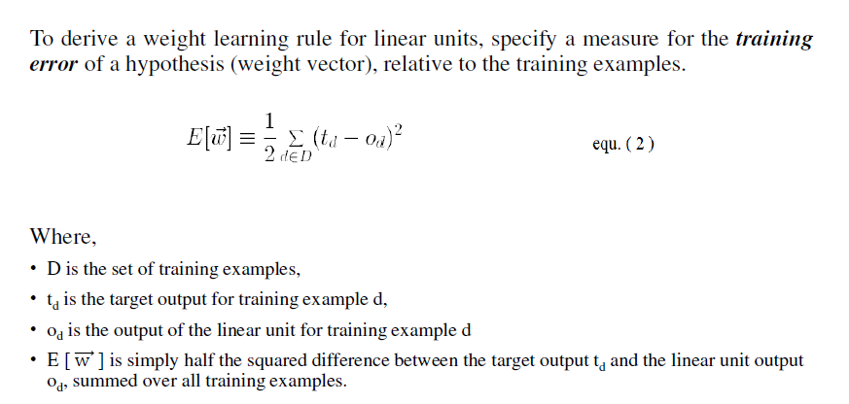

Slide 36
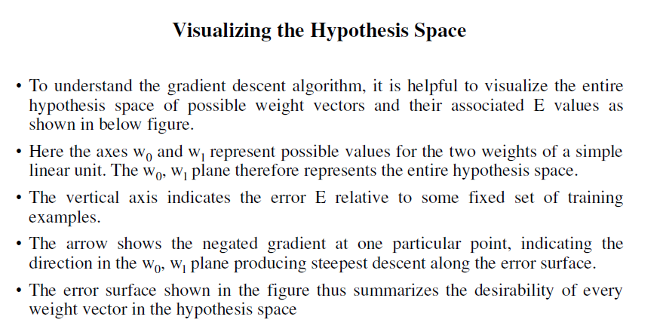
4.4.3.1

Slide 37
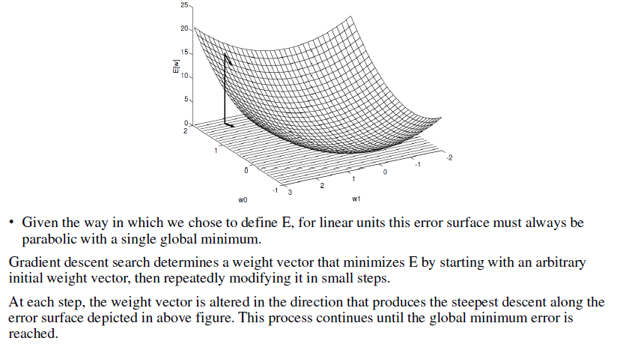

Slide 38
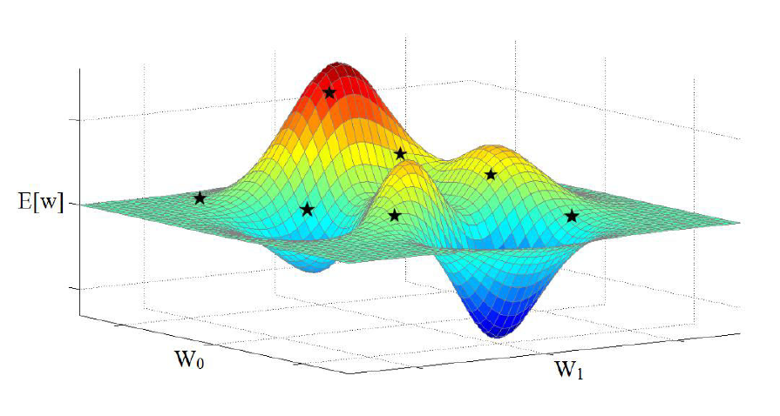

Slide 39
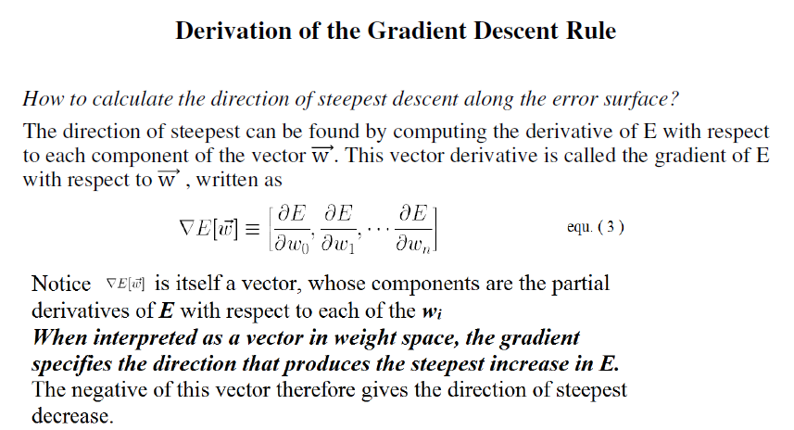
4.4.3.2

Slide 40
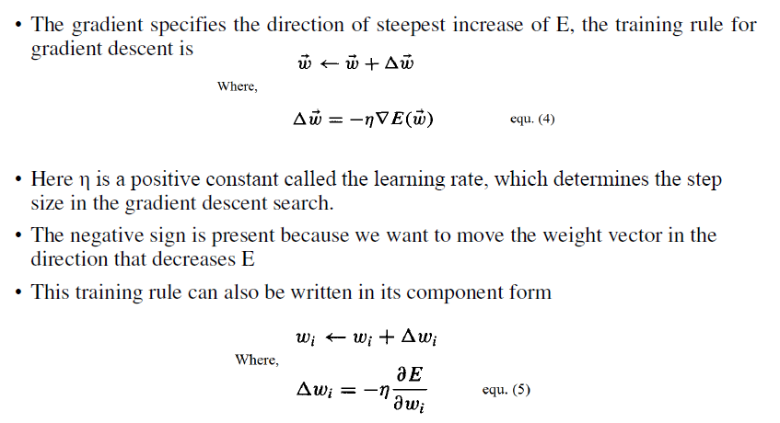

Slide 41
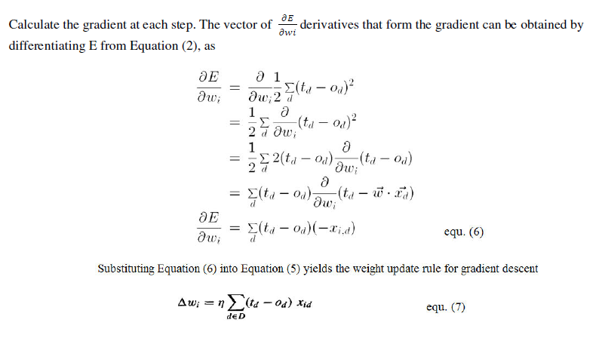

Slide 42
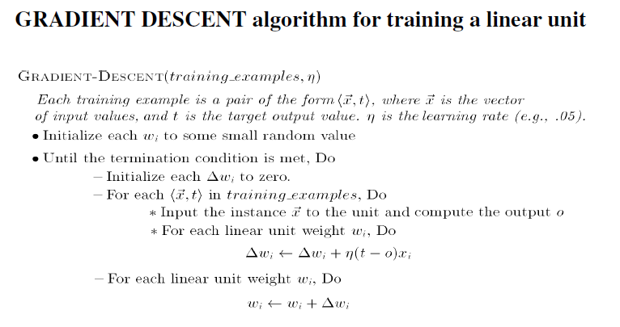
4.4.3.3

Slide 43
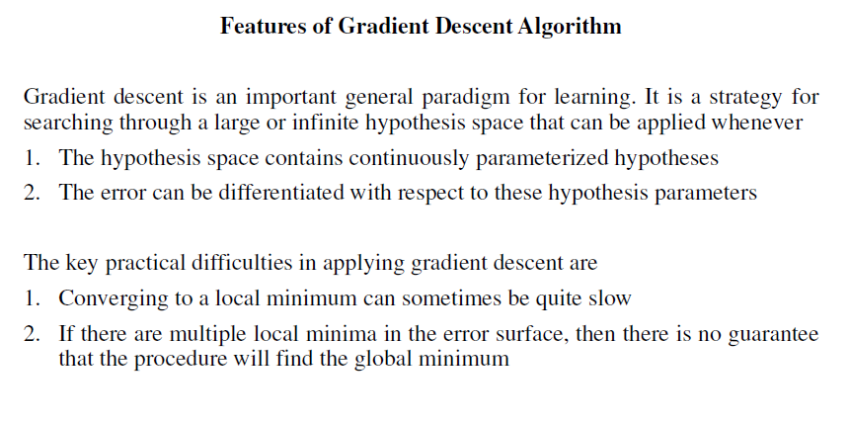

Slide 44
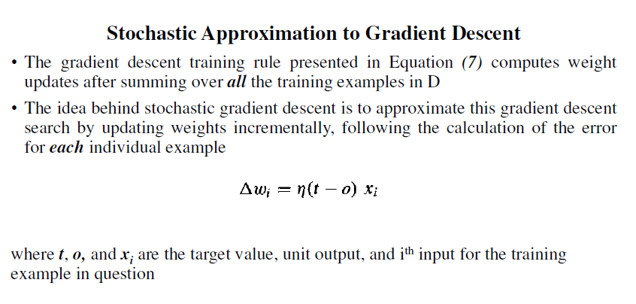
4.4.3.3

Slide 45
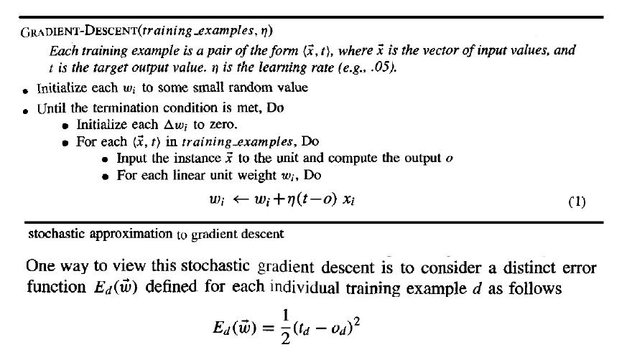

Slide 46
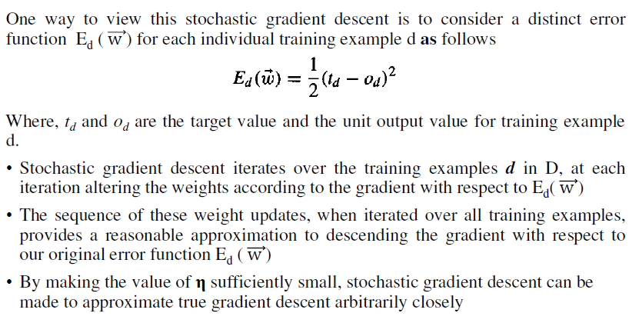

Slide 47
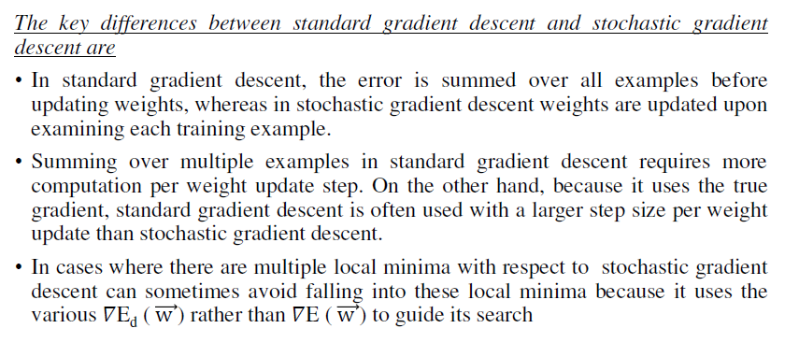

Slide 48
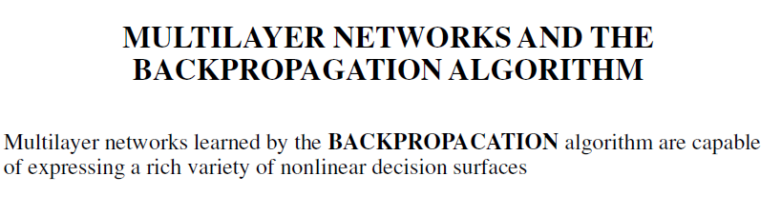
4.5
For example, a typical multilayer network and decision surface is depicted
in Figure 4.5. Here the speech recognition task involves distinguishing
among 10 possible vowels, all spoken in the context of "h-d" (i.e., "hid," "had,"
"head," "hood," etc.). The input speech signal is represented by two numerical
parameters obtained from a spectral analysis of the sound, allowing us to easily
visualize the decision surface over the two-dimensional instance space. As shown
in the figure, it is possible for the multilayer network to represent highly nonlinear
decision surfaces that are much more expressive than the linear decision surfaces
of single units shown earlier in Figure 4.3

Slide 49
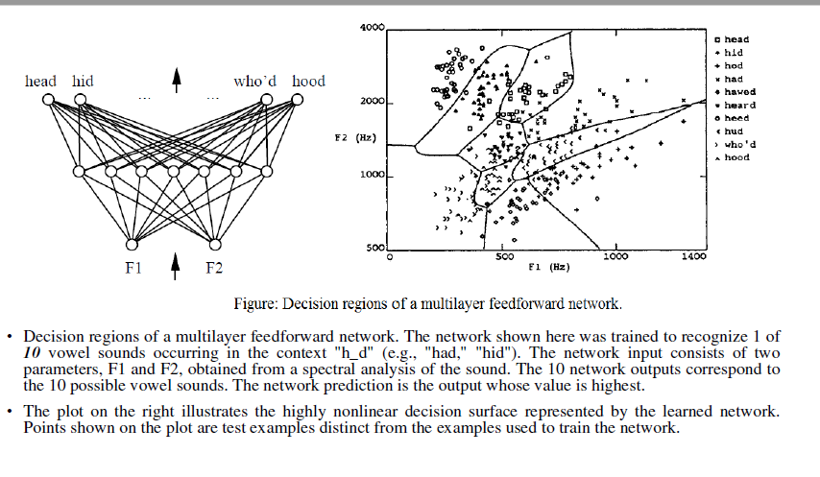

Slide 50
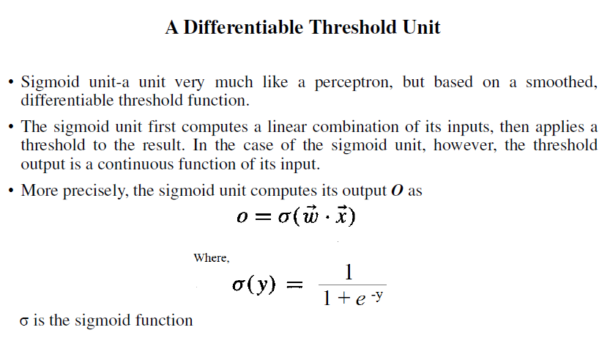
4.5.1

Slide 51


Slide 52

4.5.2

Slide 53


Slide 54


Slide 55

4.5.3

Slide 56


Slide 57


Slide 58


Slide 59


Slide 60


Slide 61

4.6
4.6.1

Slide 62


Slide 63

4.6.2

Slide 64

4.6.3

Slide 65

4.6.4

Slide 66


Slide 67


Slide 68

4.6.5

Slide 69


Slide 70


Slide 71


Slide 72


Slide 73
THANK YOU

